Slide 1
SESSION 21
Word Embeddings
Words as Vectors that Capture Meaning
Where text representation stops counting words and starts understanding them
Word2Vec · CBOW · Skip-Gram · GloVe · FastText · Cosine Similarity

Slide 2
Today's Agenda
What we'll cover in this session — roughly half theory, half hands-on code
01
From Counting to Meaning
04
Word2Vec
Why one-hot, BoW and TF-IDF fall short
CBOW and Skip-Gram explained
02
The Embedding Idea
05
GloVe & FastText
Dense vectors & the distributional hypothesis
Global counts and subword vectors
03
Measuring Similarity
06
Trade-offs & Limits
Vector space, cosine similarity, analogies
Choosing a model; what embeddings miss
Session 21 · Word Embeddings
2

Slide 3
Where Session 20 Left Off
Counting methods turn text into numbers — but the numbers carry no meaning
One-Hot, Bag of Words and TF-IDF all treat each word as an isolated symbol. They never learn that words can be related.
One-Hot
Bag of Words
TF-IDF
One 1, rest 0s
Word counts
Weighted counts
No notion of similarity
Order & meaning lost
Still just word matching
Problem: 'cat' is no closer to 'dog' than to 'helicopter'. Every word is equally distant from every other.
The fix — word embeddings
Instead of one slot per word, give every word a short list of learned numbers (a vector) so that words used in similar contexts end up close together. Meaning becomes geometry.
Session 21 · Word Embeddings
3

Slide 4
The Core Idea: Words as Dense Vectors
Each word becomes a point in space, learned from the company it keeps
“You shall know a word by the company it keeps.”
— J. R. Firth, 1957 (the distributional hypothesis)
A learned vector for “king”
0.21
Words that appear in similar contexts should have similar vectors. A model reads huge amounts of text and nudges each word's numbers until this holds true.
-0.43
0.88
0.05
-0.17
Why “dense”?
Every dimension is used and carries a little meaning — no giant blocks of zeros. Typical size: 50–300 numbers per word, not 50,000.
0.64
… a short list of numbers
Session 21 · Word Embeddings
4

Slide 5
Sparse vs Dense Representations
The shift that makes meaning possible
One-Hot / BoW (sparse)
Embedding (dense)
• Length = vocabulary size (~50,000)
• Length is small & fixed (50–300)
• Almost all values are 0
• Every value is meaningful
• No similarity between words
• Similar words ≈ nearby vectors
• New words have no slot (OOV)
• Meaning shared across dimensions
• Built by counting
• Learned from context
cat = [0,0,1,0,0,…,0]
cat = [0.21,-0.4,0.88,…]
Session 21 · Word Embeddings
5

Slide 6
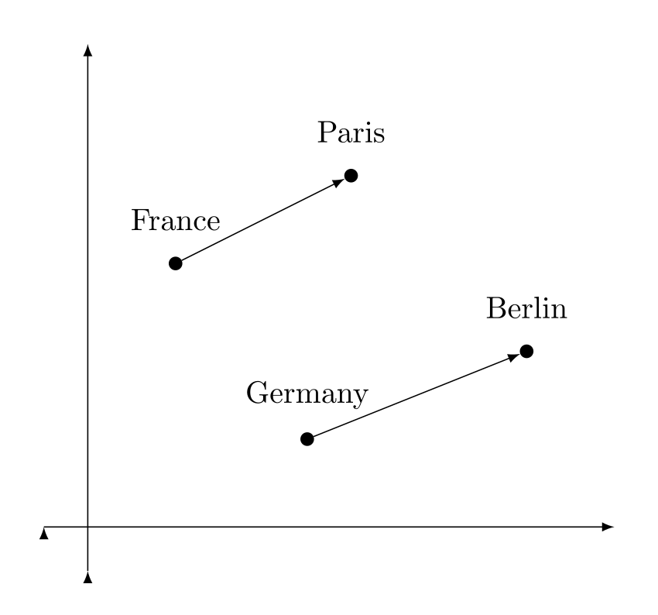
Vector Space & Semantic Similarity
Geometry encodes meaning — and even relationships between words
Once words are vectors, we can plot them. Related words cluster together, and consistent relationships become consistent directions.
Notice the parallel arrows
country → capital is the same direction for France→Paris and Germany→Berlin. The relationship is baked into the geometry.
Same for categories
Animals sit near animals, verbs near verbs — distance ≈ dissimilarity.
Word-embedding space: parallel country→capital vectors. Source: Wikimedia Commons, CC BY-SA 4.0
Session 21 · Word Embeddings
6

Slide 7
Cosine Similarity: Measuring Closeness
Compare the direction of two vectors, not their length
Two words are similar if their vectors point the same way. Cosine similarity measures the angle between them.
cos(θ) = (A · B) / (‖A‖ ‖B‖)
A “cat”
+1
same direction → very similar
B “dog”
0
perpendicular → unrelated
θ small
−1
opposite → very different
Small angle → high cosine → similar meaning
Session 21 · Word Embeddings
7

Slide 8
Word Analogies: Arithmetic on Meaning
Relationships become vector addition and subtraction
vec(“king”) − vec(“man”) + vec(“woman”) ≈ vec(“queen”)
Remove ‘maleness’, add ‘femaleness’ — and you land near the right word.
king − man + woman
paris − france + italy
walking − walk + swim
↓
↓
↓
queen
rome
swimming
A useful caution
These analogies are real but cherry-picked — they don't always hold. Treat them as intuition, not proof.
Session 21 · Word Embeddings
8

Slide 9
Word2Vec: Learning Vectors by Prediction
Mikolov et al., Google, 2013 — the breakthrough that made embeddings practical
Train a shallow neural network on a simple prediction game over a sliding window of text. We don't care about the predictions — the hidden-layer weights become the word vectors.
1
2
3
4
→
→
→
Slide a window
Predict
Adjust weights
Read off vectors
over the text, word by word
a word from its neighbours (or vice-versa)
so good guesses score higher
the trained weights = embeddings
Two flavours of the same idea
CBOW predicts a word from its context. Skip-Gram predicts the context from a word. We'll see both next.
CBOW — context → word
Skip-Gram — word → context
Session 21 · Word Embeddings
9

Slide 10
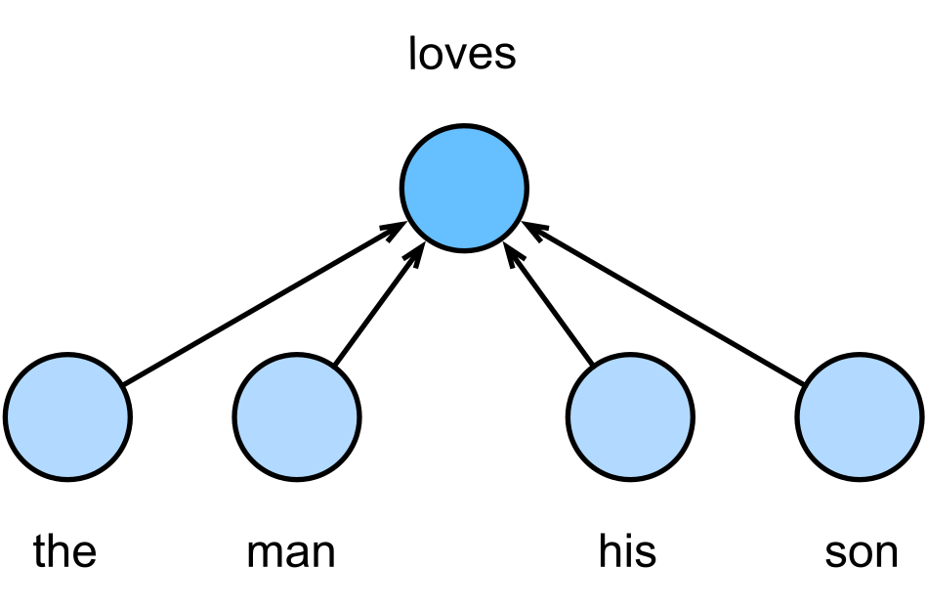
CBOW — Continuous Bag of Words
Predict the centre word from the surrounding context
How it works
• Take the words around a blank
• Average their vectors together
• Use that to predict the missing word
• Fast to train; smooths over the context
Best when
You have a smaller dataset and care about frequent words. CBOW is quicker and represents common words well, but pays less attention to rare ones.
CBOW: context “the, man, his, son” → predict “loves”. Source: Wikimedia Commons (D2L), CC BY-SA 4.0
Session 21 · Word Embeddings
10

Slide 11
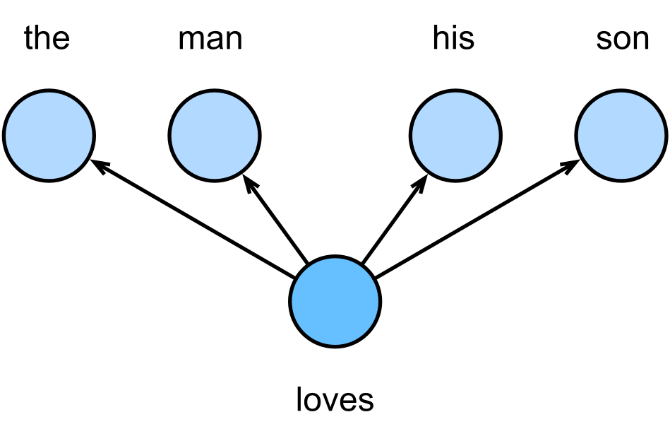
Skip-Gram — Predict the Context
Flip CBOW around: from one word, guess its neighbours
How it works
• Take one target word
• Predict each surrounding word in turn
• Generates many training pairs
• Slower, but learns rare words well
Best when
You have a large corpus and want high-quality vectors, including for infrequent words. Skip-Gram (with negative sampling) is the most popular Word2Vec setup.
Skip-Gram: “loves” → predict “the, man, his, son”. Source: Wikimedia Commons (D2L), CC BY-SA 4.0
Session 21 · Word Embeddings
11

Slide 12
CBOW vs Skip-Gram at a Glance
Same engine, opposite direction — pick by data size and goal
Aspect
CBOW
Skip-Gram
Predicts
Centre word from context
Context from centre word
Direction
context → word
word → context
Training speed
Faster
Slower
Frequent words
Strong
Good
Rare words
Weaker
Stronger
Typical use
Smaller datasets
Large datasets
Session 21 · Word Embeddings
12

Slide 13
GloVe — Global Vectors
Pennington, Socher & Manning, Stanford, 2014
Word2Vec learns from local windows. GloVe instead uses global co-occurrence counts — how often word pairs appear together across the whole corpus — and factorises that table into vectors.
Co-occurrence counts (toy)
solid
gas
water
ice
35
2
18
steam
3
31
16
Key insight
Ratios of co-occurrence probabilities carry meaning. ice co-occurs with solid more than steam does — that ratio defines the dimension.
water
12
11
40
GloVe factorises this whole table into vectors
In practice
Captures global statistics and trains efficiently. Pre-trained GloVe vectors (Wikipedia + Gigaword, Twitter) are widely used off-the-shelf.
Session 21 · Word Embeddings
13

Slide 14
FastText — Words Made of Pieces
Bojanowski et al., Facebook AI, 2017 — embeddings from subword n-grams
Word2Vec & GloVe treat each word as atomic, so a word they never saw has no vector. FastText represents a word as the sum of its character n-grams (subwords).
“where” → broken into character n-grams:
<wh
whe
her
ere
re>
<where>
word vector = sum of these subword vectors
Handles unknown words
Understands morphology
A new or misspelled word still gets a vector from its pieces — no more out-of-vocabulary gaps.
‘play’, ‘playing’, ‘played’ share subwords, so related forms get related vectors — great for rich languages.
Session 21 · Word Embeddings
14

Slide 15
Word2Vec vs GloVe vs FastText
Three classic ways to learn static word vectors
Word2Vec
GloVe
FastText
Learns from
Local context windows
Global co-occurrence
Subword n-grams
Unknown words
Cannot handle
Cannot handle
Handles well
Morphology
Ignored
Ignored
Captured
Training
Predictive NN
Matrix factorisation
Predictive + subwords
Best for
General purpose
Fast, global stats
Rare words & typos
Author / year
Google, 2013
Stanford, 2014
Facebook, 2017
Session 21 · Word Embeddings
15

Slide 16
What These Embeddings Still Miss
Powerful, but ‘static’ — one vector per word, no matter the sentence
“I sat on the river bank.” vs “I deposited cash at the bank.”
Same single vector for “bank” — the model can't tell the two meanings apart.
!
One vector per word
Polysemy (multiple meanings) is collapsed into one point.
What comes next
Contextual embeddings (ELMo, BERT, and modern transformers) give a word a different vector in every sentence — solving exactly this problem. That's our bridge to the next sessions.
!
Context-free
The vector never changes with the surrounding sentence.
!
Can absorb bias
Vectors learn social biases present in the training text.
Session 21 · Word Embeddings
16

Slide 17
RECAP & WHAT'S NEXT
Session 21 in Five Ideas
1
Words → vectors — Dense numbers learned from context replace sparse counts.
2
Meaning is geometry — Cosine similarity and analogies fall out of the vector space.
3
Word2Vec — CBOW (context→word) and Skip-Gram (word→context).
4
GloVe & FastText — Global co-occurrence; subwords for unknown words & morphology.
5
Static limits — One vector per word — contextual models come next.
Hands-on next: train Word2Vec, measure cosine similarity, and solve analogies in the notebook.

